Slide 1

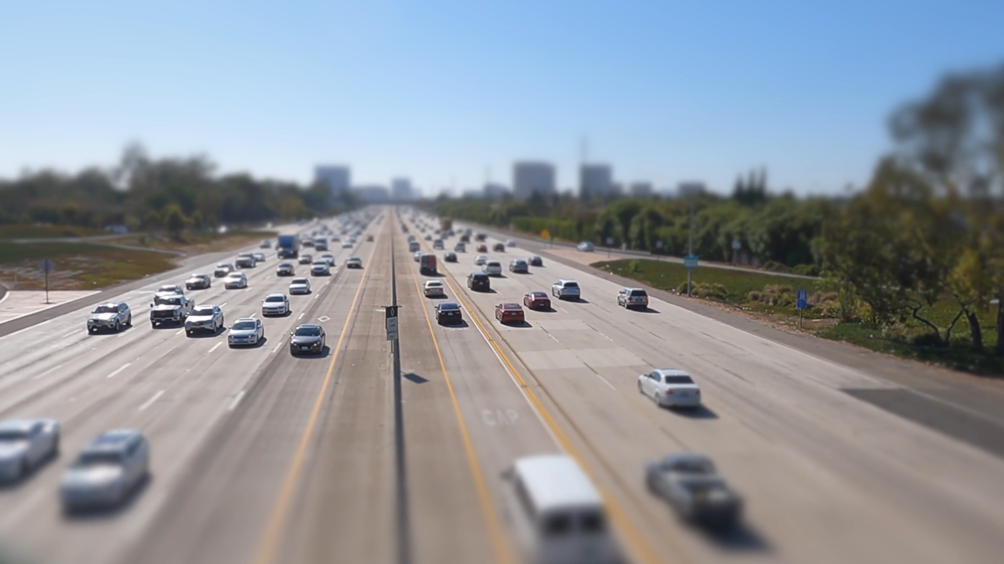
MOVING OBJECT DETECTION
Team members:
2010030087- Pavan Vikhyath
2010030359-Venkatesh.K
2010030364-Yashwanth.K
2010030520-Karthik
Guide :
Dr . Arpita gupta

Slide 2
TABLE OF CONTENTS:
ABSTRACT
OBJECTIVES
LITERATURE SURVEY
DATASETS AND TECHNIQUES
PROBLEM STATEMENT
CONCLUSION

Slide 3
Moving object detection are the more important and challenging task in video surveillance and computer vision applications.The main purpose of this project is to build a moving object detection. It is used to track the object type(such as human, vehicles) and detect the movement of the object(such as moving, standing).
It is well suited for a broad range of applications which includes, video communication, security and surveillance, public areas such as airports, traffic control, monitoring activities at traffic intersections for detecting congestions, The proposed work focused on bringing effective and efficient system with intelligence to avoid human intervention in identifying security threats.
ABSTRACT :

Slide 4
OBJECTIVES:
Automatic tracking of objects can be the foundation for many interesting
applications. An accurate and efficient tracking capability at the heart of such a
system is essential for building higher level vision-based intelligence.
1. (a) Set up a system for automatic object segmentation and tracking in moving camera video scenes, which can be used as a basis for higher-level reasoning tasks and applications.
2. (b) To make significant improvements in commonly used algorithms. Finally,
Our goal is to demonstrate how to detect
And track moving object in a video from a moving camera using motion based tracking

Slide 5
Literature survey :
1.A Survey on Moving Object Detection and Tracking Techniques:
Authors: Shilpa , Prathap H., Sunitha M.R
Detection of objects in motion is the first step
towards non-stationary object tracking. Some of the major and important methods of
detecting the moving objects are Frame differencing, Optical
flow, Background subtraction and Double difference etc.
Reference link: https://www.researchgate.net/publication/301775263_A_Survey_on_Moving_Object_Detection_and_Tracking_Techniques
2.Object detection and Object tracking in Videos
Authors: S. Rosi , W. Thamba Meshach, J.Surya Prakash
Video surveillance system for the purpose of security has been developed. Many researches try to develop intelligent video surveillance systems
Reference links:http://www.ijsrp.org/research-paper-1114/ijsrp-p3553.pdf

Slide 6
S.NO | Authors | Title | Publishing | Techniques & dataset | Pros | Cons
1 | Suresh Kumar , Prof. Yatin Kumar Agarwal | Computer Vision Based Moving Object Detection and Tracking | 2020 | Customized dataset | This is significantly improved and facilitated the performan ce of certain computer vision tasks, such as tracking, video surveillance, motion - based recognition, video indexing, human - computer interaction, traffic monitoring, and vehicle navigation | There is no Movement detection and this is not capable of finding the objects which are in motion in every frame with respect to the previous frame
2 | Risha K, Chempak Kumar | Novel method of detecting moving object in video | 2016 | Customized dataset | moving object is detected by using optical flow, .Morphological closingis applied to get a clear picture of the moving target. | Camera cannot move and cannot detect Multiple objects
3 | Sunitha m.r | Moving object detection | 5 May 2016 | Customized datatset | In this survey we found that Among various detection methods Background subtraction is the simplest method which provides complete information | There is no accurate video surveillance due to background subtraction
4 | Darshak G. Thakore | Moving object detection | 3, July 2012 | Customized datatset | This survey is helpful for us to analize image enhancement motion detection object tracking etc | The results of the experiments or survey done where satisfactory and had some issues like boot strapping dynamic background etc
5 | Surya Prakash.J | Moving detection object | 11,November, 2014 | Customized datatset | This survey shows various methodologies for object detection and tracking such as background subtraction ,and , background modeling, ,less sensitive to background noise. | There is no accurate video surveillance due to background subtraction

Slide 7
datasets | characteristics | techniques/methods
VIVID AND CDNET | Dataset contains totaly 4107 frames and 13834 labeled bounding box for moving targets. . The dataset consists of 8 different subset images. | 1.KLT(kanade-lucas-tomasi) 2.RANSAC (random sample consensus)
KITTI MOD | 1.KITTI MOD data and The Davis [21] benchmark are used. 2. DAVIS is comprised of 50 sequences, with 3455 total number of frames. | 1.GPS (global positioning system) 2.IMU (inertial measurements units)

Slide 8
DistSurf2 | 1.This camera has a 346 × 260 spatial resolution and outputs frames up to 60 frames per Second 2. This dataset contains sequences (both events and their corresponding grayscale images) captured in both indoor and outdoor environments, involving multiple moving objects | GMM (gaussian mixture model)

Slide 9
REFRENCES:
Cite:
1.UAV IMAGES DATASET FOR MOVING
OBJECT DETECTION FROM MOVING CAMERAS.
Delibasoglu, Ibrahim. "UAV Images Dataset for Moving Object Detection from Moving Cameras." arXiv preprint arXiv:2103.11460 (2021).
2. MODNET:Motion and Appearance based
Moving Object Detection Network for
Autonomous Driving
Siam, Mennatullah, Heba Mahgoub, Mohamed Zahran, Senthil Yogamani, Martin Jagersand, and Ahmad El-Sallab. "Modnet: Motion and appearance based moving object detection network for autonomous driving." In 2018 21st International Conference on Intelligent Transportation Systems (ITSC), pp. 2859-2864. IEEE, 2018.
3.MOVING OBJECT DETECTION FOR EVENT-BASED VISION USING GRAPH SPECTRAL CLUSTERING
Mondal, Anindya, Jhony H. Giraldo, Thierry Bouwmans, and Ananda S. Chowdhury. "Moving Object Detection for Event-based Vision using Graph Spectral Clustering." In Proceedings of the IEEE/CVF International Conference on Computer Vision, pp. 876-884. 2021.

Slide 10
PROBLEM STATEMENT
The results of all the experiments and test done over the moving object detection were satisfactory. In most of the experiments the results were not accurate,as most of the experiments were carried out using the cameras, Background subtraction is still an open issue with several scientiﬁc obstacles to overcome and these obstacles are :-
Bootstrapping
Dynamic background
Foreground aperture
Illumination changes
Low frame rate
Motion blur, etc.
In addition, these challenges are less or more predominant depending on the real-applications. For example in surveillance in natural environments like in maritime and aquatic environments, illumination changes and dynamic
changes in the background are very challenging .

Slide 11

CONCLUSION
By taking this topic, we have aimed to produce optimised solution for the obstacles that have come up in the experiments we have seen till date. An app or a product that can detect moving objects can be useful in video surveillance, activity recognition, road condition monitoring, airport safety, monitoring of protection along marine border, etc. Our attempt here is to try to develop a better solution by not starting from the scratch for a problem instead developing on the solutions given many people around us.

